Slide 1

Coding in Teams:
Divide and Conquer
Todd Schmitt
Senior Software Consultant at
Centare

Slide 2
Questions
  Why is this a big deal?
  What does the team look like?
  How do I slice the work?
  What does it look like in practice?

Slide 3


Slide 4
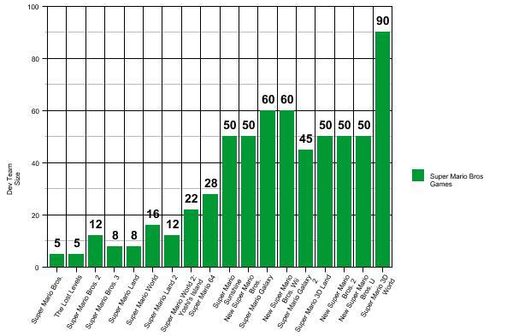
Mario Game Team Sizes
1983
2013

Slide 5
More Team Sizes
Grand Theft Auto 5 (2013) – Team size of ~ 1000
Witcher 3: The Wild Hunt (2015) – ~240 in-house staff, and 1000 around the world
The Elder Scrolls V: Skyrim (2011) – 100
Half Life 2 (2004) – 40 (Note: Valve as a company has ~ 300 employees)
Fallout (1997) – 30
Deus Ex (2000) – 20

Slide 6
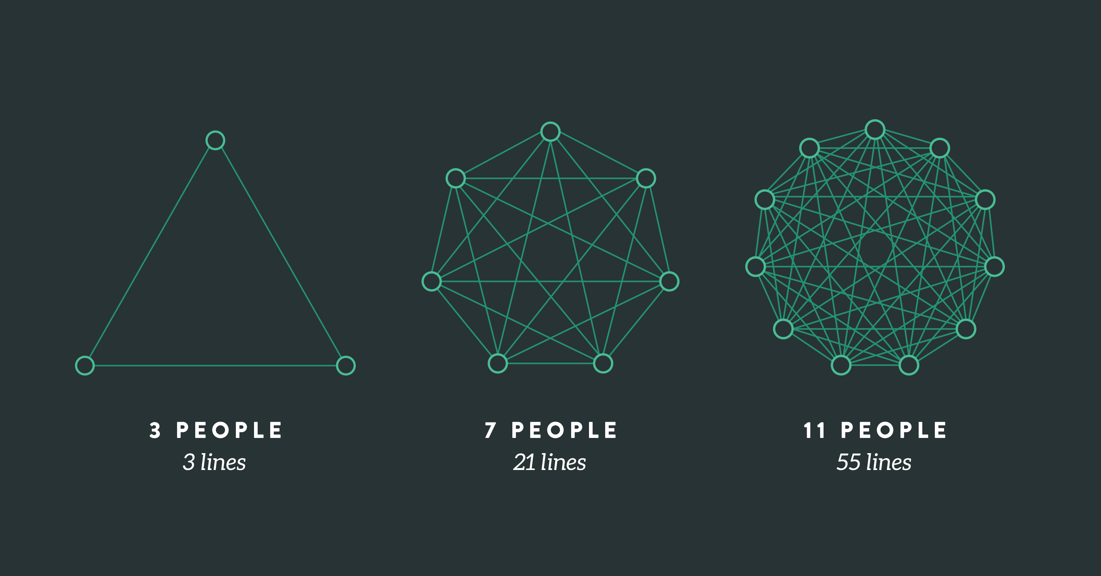

Slide 7
Face-to-face conversations are the heart and soul of agile projects. Agile meetings provide a format for communicating in a face-to-face environment.
Mark C. Layton, Author of ‘Agile Project Management for Dummies’

Slide 8
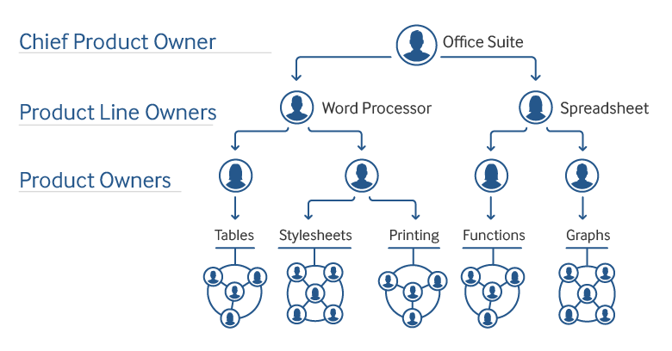

Slide 9
Stories/PBIs/Tasks
Captures requirements for the system that you’re building.
Have different names depending on the development framework.

Slide 10
Why break down Stories?
Get whole parts done each sprint
More efficient for team
Less roadblocks
Demo early
Allows prioritization

Slide 11
Need to break down Stories when:
Work is carrying over from sprints
Stories don’t close because of roadblocks
Some team members starved for work
PO doesn’t see changes until all work complete

Slide 12

Decomposing Stories
Breaking stories into smaller slices

Slide 13
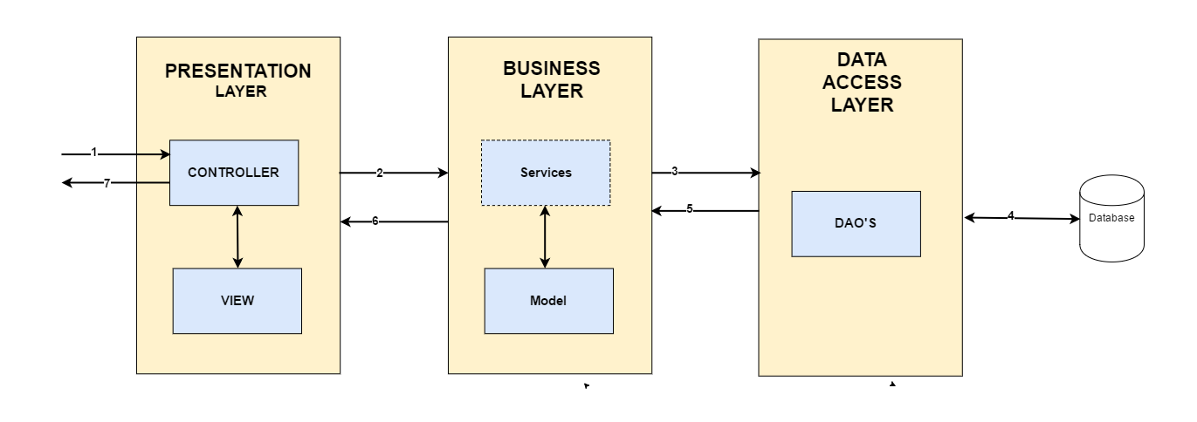
Horizontal breakdown
Horizontal break-down: Involves breaking down stories by the kind of work that needs to be done, or the layers or components that are involved.

Slide 14
Horizontal Slices
The Bad:
  Bottlenecks
  Getting out of sync
  Hard to demo
  Requires people to have foresight
The Good:
  Decreased training for specialist areas

Slide 15
Vertical breakdown
Vertical break-down: user stories are broken down into smaller user stories (instead of technical tasks). If user stories are broken down vertically, they are broken down in such a way that smaller items still result in working, demonstrable, software.

Slide 16
CRUD Breakdown
As an online shopper…
… I want to be able to create a new account.
As an online shopper I want to manage my user profile so I can view and update my account details and settings.
… I want to view my account details.
… I want to update my account details.
… I want to cancel my account.

Slide 17
Business Rules Breakdown
As a customer…
… I want to be able to input a driver’s license number to complete a purchase
As a customer I can purchase goods only if I’m an adult.
… I want to be able to provide a credit card number to complete a purchase.
… I can opt not to provide proof of age and my order will be cancelled.

Slide 18
Data Types/ Parameters Breakdown
As a customer…
… I can search for products by the product number.
As a customer I can search for products so that I can view and order them.
… I can search for products by a price range.
… I can search for products available with free shipping.
… I can search for products by size.

Slide 19
Test Cases Breakdown
As a manager…
… I can assign employees to one or more shifts in a day.
As a manager I can assign workers to shifts so I can fill all available shifts.
… I cannot assign an employee two overlapping shifts.
… I can assign multiple employees to the same task at one time.
… I cannot assign employees who have an inactive status.

Slide 20
Getting a specification instead of a story
Specification:
  All page elements
  Validation
  Styling
  Button behaviors
  Non-standard UI behavior
  Enabling and disabling elements

Slide 21
Vertical Slices
The Bad:
  Developers have to know more technical domains
  Requires different manager thinking
The Good:
  Cross training
  Sense of accomplishment
  Stays in sync
  Can demo and ship stories that are done

Slide 22
Putting it Together
Can split tasks/features even in waterfall
Managers get benefits too
Use mocks to eliminate
Split when you have to, ahead of time
  Process before sprint and during sprint as needed

Slide 23
Sources
http://www.pmpaul.com/happens-many-cooks-kitchen-team-size/
https://medium.com/the-liberators/10-powerful-strategies-for-breaking-down-user-stories-in-scrum-with-cheatsheet-2cd9aae7d0eb
https://www.excella.com/insights/make-your-agile-user-stories-manageable-through-story-decomposition
https://www.leadingagile.com/2018/02/applying-brooks-law/
https://nintendo-online.de/artikel/report/18111/inside-nintendo-47-das-super-mario-entwicklerteam-unter-der-lupe

Slide 24
Todd Schmitt
https://www.linkedin.com/in/todd-schmitt-baa0a16
https://toddcan.code.blog/
Todd.Schmitt@Centare.com

